Slide 1
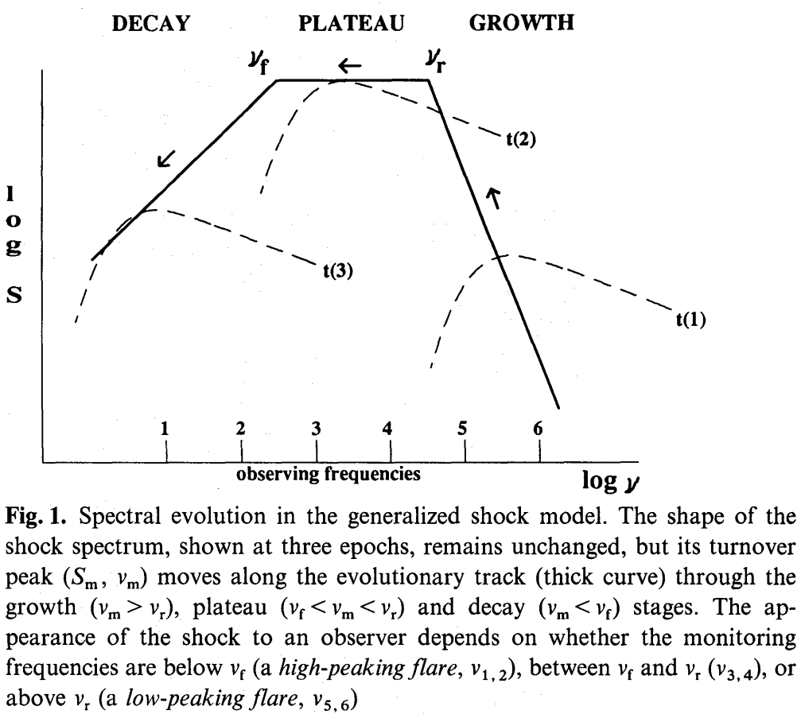
Generalized Shock Model for observational analysis
Assumption：
1. SED is self-similar throughout the shock process
2. Turnover frequency relates to time through $ν_{m}∝t^{k}$
Stage | $$S_{m}$$ | Physical Argument
Growth | $∝ν_{m}^{a}；a\sim −2.5$ | Shock formation process
Plateau | Const. | Energy losses and energy gain balanced
Decay | $$∝ν_{m}^{b}；b\sim +1$$ | Expansion and other losses extinguish shock
Understand the M&G model using this generalized concept!
$$S_{m}\sim ν^{−0.2}$$
$$S_{m}\sim ν^{2.5}$$
Valtaoja, A&A, 254, 71 (1992)

Slide 2
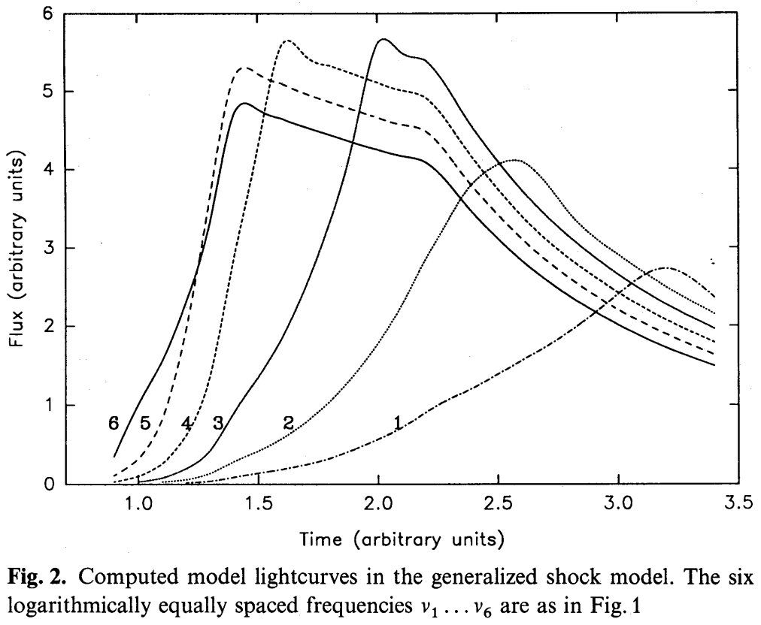
Generalized Shock Model in light curve behavior
For $ν>ν_{r}$, they reach the peak of the light curve at the same time. The higher the frequency, the lower the flux level.
$$t_{2}$$
$$t_{1}$$
For$ν_{f}<ν<ν_{r}$, they peak when $ν=ν_{m}$. The peak flux doesn’t change much with frequency.
$$S_{m}\sim ν^{−0.2}$$
$$S_{m}\sim ν^{2.5}$$
Valtaoja, A&A, 254, 71 (1992)
For $ν<ν_{f}$, they peak when $ν=ν_{m}$. The peak flux decays with frequency and depends on how the shock dissipates.
*Note that this only holds true iff the shock dissipation is slower than power law index 2.5. (b<2.5)
Peak time scales with freq.
$$t_{1}$$
$$t_{2}$$

Slide 3
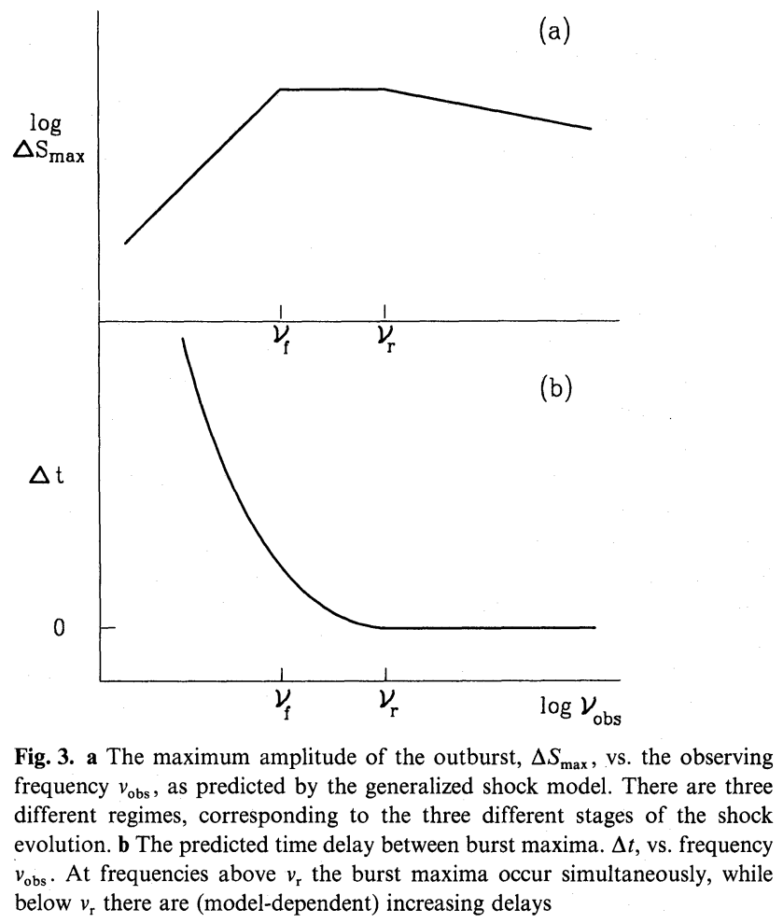
Generalized Shock Model in light curve analysis
For $ν>ν_{r}$, they reach the peak of the light curve at the same time. The higher the frequency, the lower the flux level.
For $ν_{f}<ν<ν_{r}$, they peak when $ν=ν_{m}$. The peak flux doesn’t change much with frequency.
For $ν<ν_{f}$, they peak when $ν=ν_{m}$. The peak flux decays with frequency and depends on how the shock dissipates.
*Note that this only holds true iff the shock dissipation is slower than power law index 2.5. (b<2.5)
Peak time scales with freq.
$$t_{1}$$
$$t_{2}$$

Slide 4
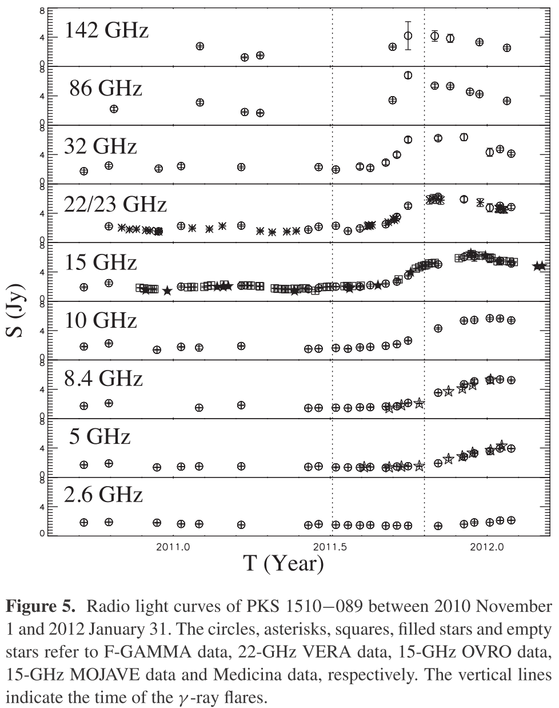
Example：PKS 1510-089
Flux level rising：$ν>ν_{r}$
Flux level at max： $ν_{f}<ν<ν_{r}$
Flux level falling：$ν<ν_{f}$
Orienti, MNRAS, 428, 2418 (2013)

Slide 5
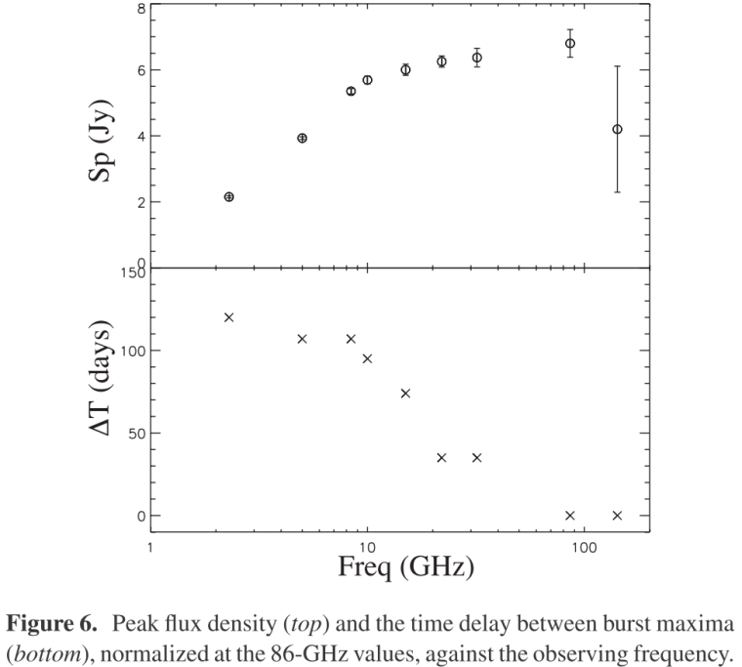
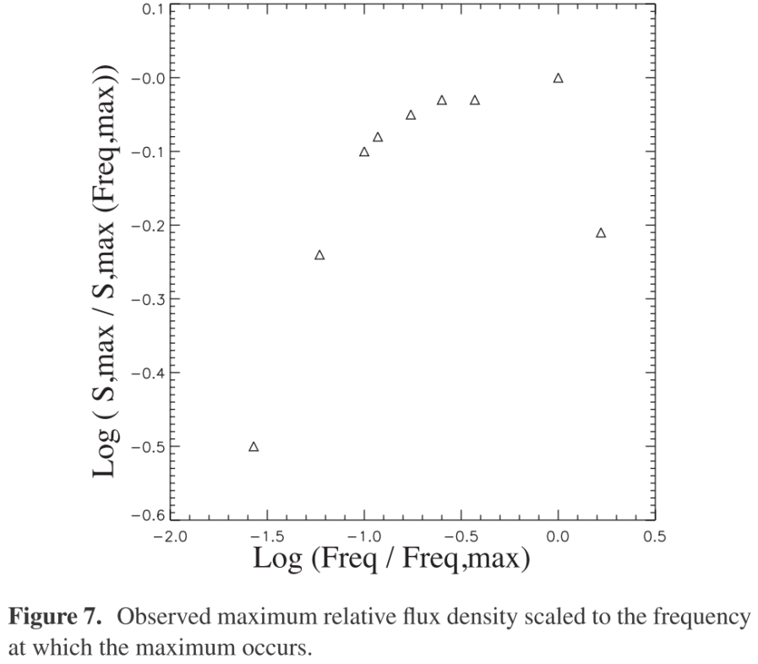
Example：PKS 1510-089
Orienti, MNRAS, 428, 2418 (2013)
Valtaoja, A&A, 254, 71 (1992)
$$S_{m}\sim ν^{−0.2}$$
$$S_{m}\sim ν^{2.5}$$
Valtaoja, A&A, 254, 71 (1992)
Orienti, MNRAS, 428, 2418 (2013)

Slide 6
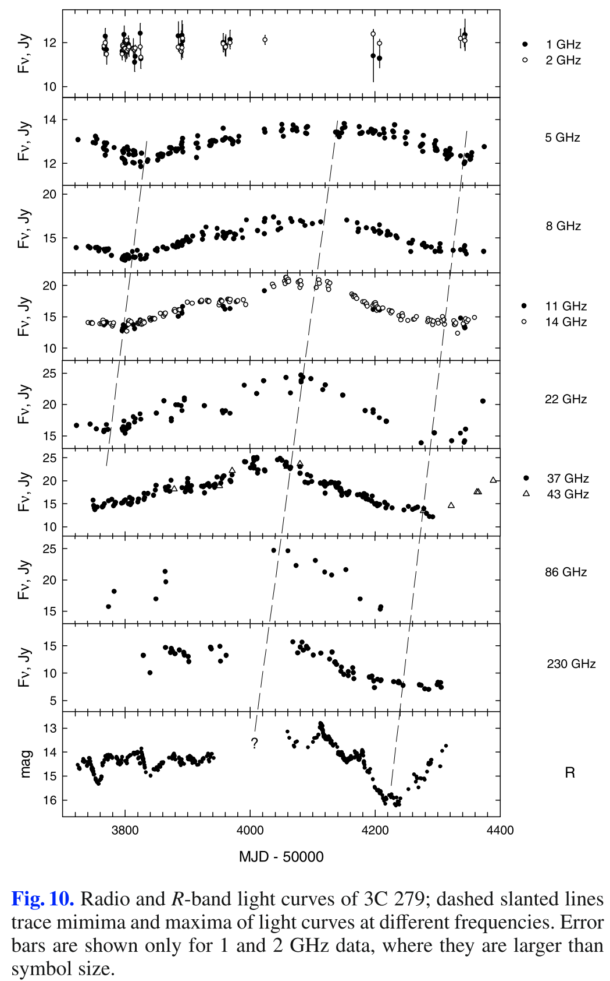
Example：3C 279
Flux level falling：$ν<ν_{f}$
Flux level at max： $ν_{f}<ν<ν_{r}$
Flux level rising：$ν>ν_{r}$
Larionov, A&A, 492, 389 (2008)

Slide 7
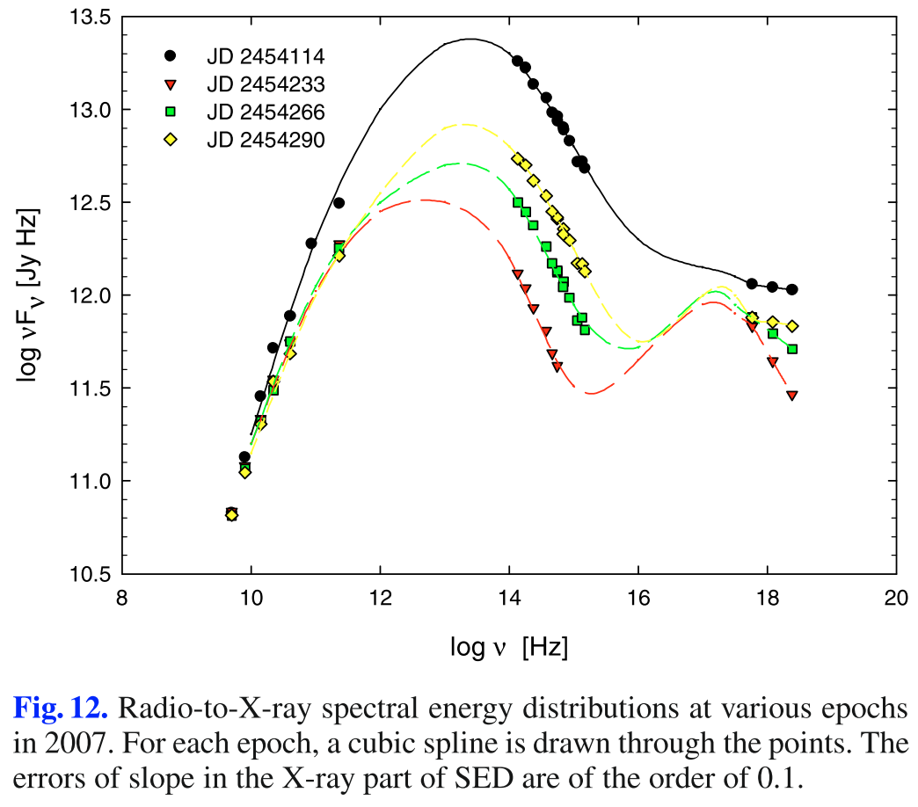
Example：3C 279 – self similarity of SED
Larionov, A&A, 492, 389 (2008)
$$S_{m}\sim ν^{−0.2}$$
$$S_{m}\sim ν^{2.5}$$
Valtaoja, A&A, 254, 71 (1992)

Slide 8
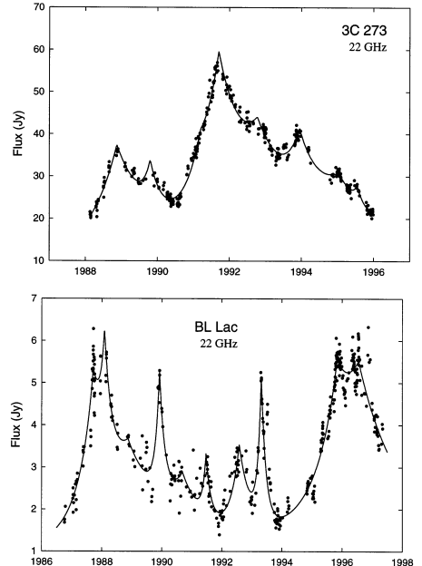
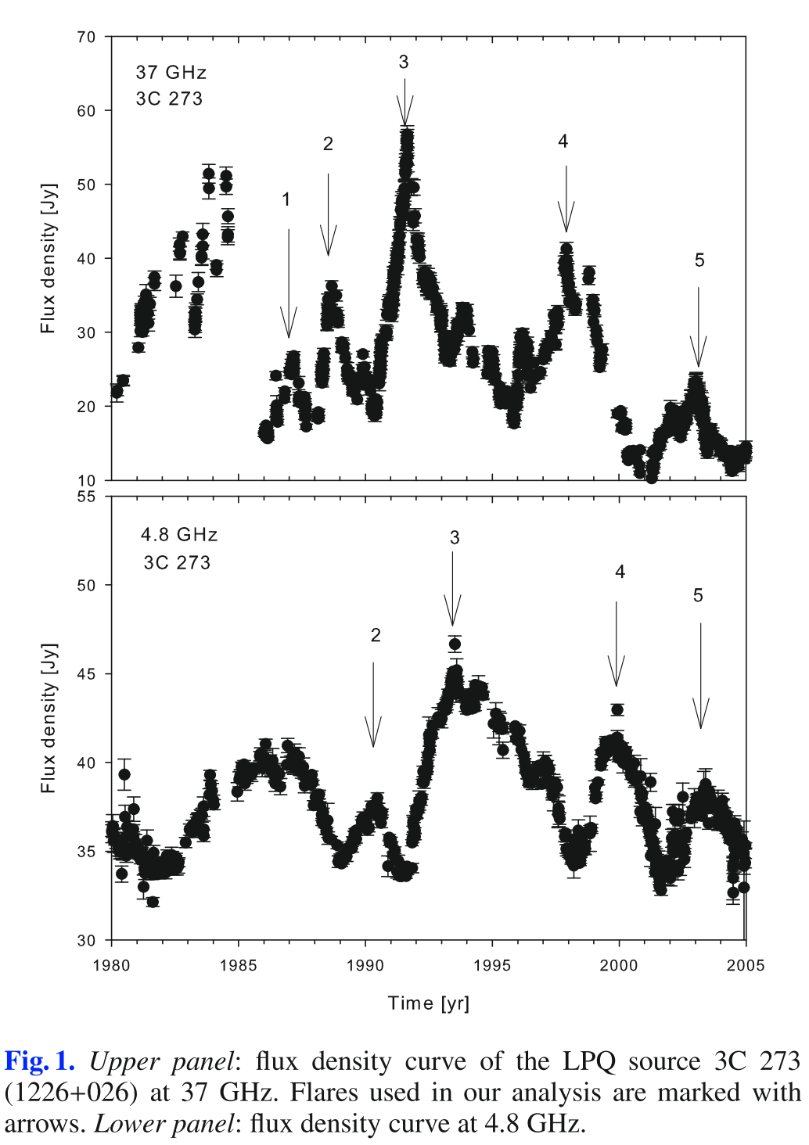
Counter (?) Examples
Valtaoja, ApJS, 120, 95 (1999)
Hovatta, A&A, 485, 51 (2008)
Plateau Stage in the generalized shock model seems to be missing??

Slide 9
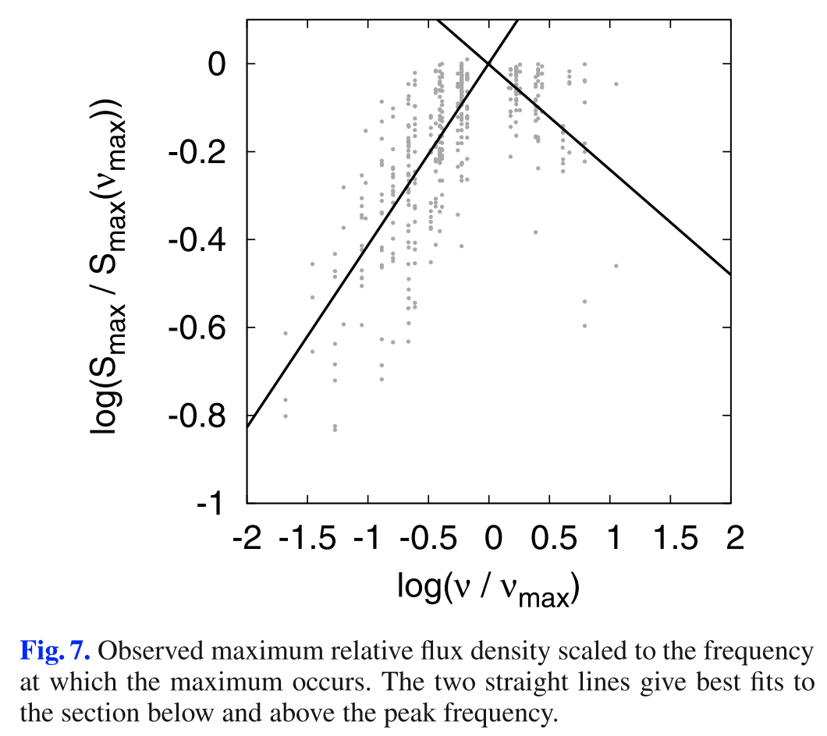
Where is the Plateau Stage ???
What happened ?
Hovatta+ 2008 discusses a population of 55AGNs with multiple flares … so this doesn’t look like a lone phenomena…
However, this isn’t explained YET! As we have seen in the cases of PKS1510-089 and 3C 279, the plateau stage seems to be there…
Hovatta, A&A, 485, 51 (2008)
There seems to be no explanation to this YET???? (one more thesis topic ☺)
$$S_{m}\sim ν^{−0.2}$$
$$S_{m}\sim ν^{2.5}$$
Valtaoja, A&A, 254, 71 (1992)

